Slide 1
High School to College Transition:
Identifying and Supporting Student Mental Health Needs
Heather LaPier, LMSW, School Social Worker, Grand Island High School
Anne Nowak, MS, LMHC Coordinator, Sweet Home Family Support Center

Slide 2
32% of college students meet diagnostic criteria for a mental illness in any one year
40% of students felt so depressed in the past year they had difficulty functioning
Only 40% of students with mental health issues seek treatment
20% of students have considered suicide at some point in their college career
The Conversation via the American College Health Association; JED Foundation (2017)

Slide 3

Common issues seen in most high school students
Inability to cope with transition out of High School
Lack of independence
Difficulty with self advocacy skills
Difficulty with Decision Making skills
Struggle with Personal Responsibility for actions/choices
Fear of the unknown
Lack of healthy Stress Management skills

Slide 4
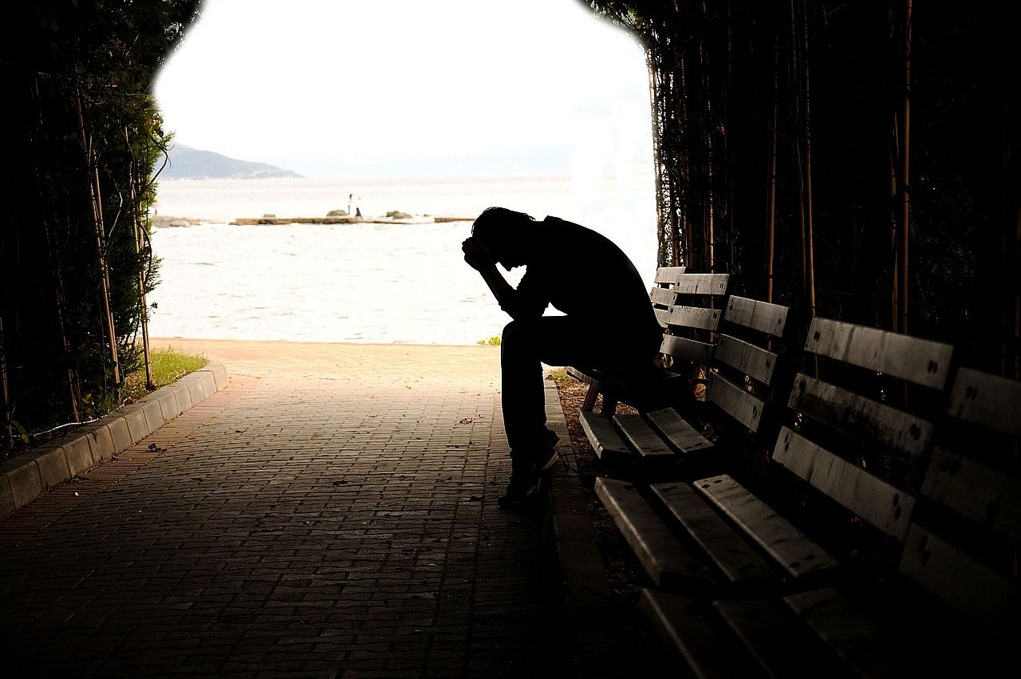
Students with mental health issues are dealing with typical issues and more
Depression
Anxiety
Mood Disorders (ie Bipolar Disorder)
Personality Disorders
PTSD/Trauma Based Issues
Eating Disorders
Substance Abuse
Notes:
Not only can these issues have environmental causes but some are organic that will require medication management

Slide 5
Mental Health Issues seen in High School Students
In 2018, Healthcare professionals and parents surveyed by WebMD/Medscape in collaboration with JED, stated that in the past five years
86% said teens have more anxiety and stress
81% saw more anxiety disorders
70% reported seeing more mood disorders such as depression and bipolar disorder
45% of parents said that their child has been diagnosed or treated for a mental health issue , learning disorder or substance abuse problem.
Only 17% of those parents considered access to mental health services and on campus counseling when rating schools for their children
Notes:
Why: Digital age- decrease in communication/social skills, interactions are on social media, instant interactions/no filters, reality TV, everyone knows what you are doing, screen time

Slide 6
Emotionally needy high school seniors become needy college freshman
Used to small, safe environment that provided support
Adults that knew them, established relationships
Coping skills that worked in the high school may not work or be available on a college campus (pass out of class, unscheduled visit to student services, extra time to complete assignments)
Adults that advocated for their needs are gone (parents, school counselors)
Friends that provided support are no longer there

Slide 7
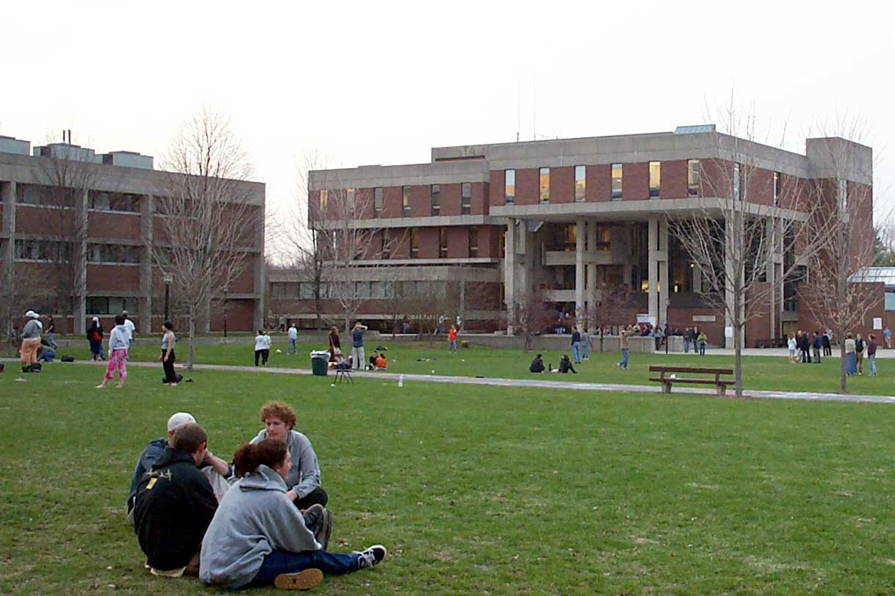
What happens when these students come to college campuses?
The demand for mental health services on college campuses has risen steadily over the past 7 years . The most common conditions were anxiety and depression
Depressed and anxious students are more likely to be absent, take semesters off, and/or drop out of school.
(2017,Center for Collegiate Mental Health)

Slide 8
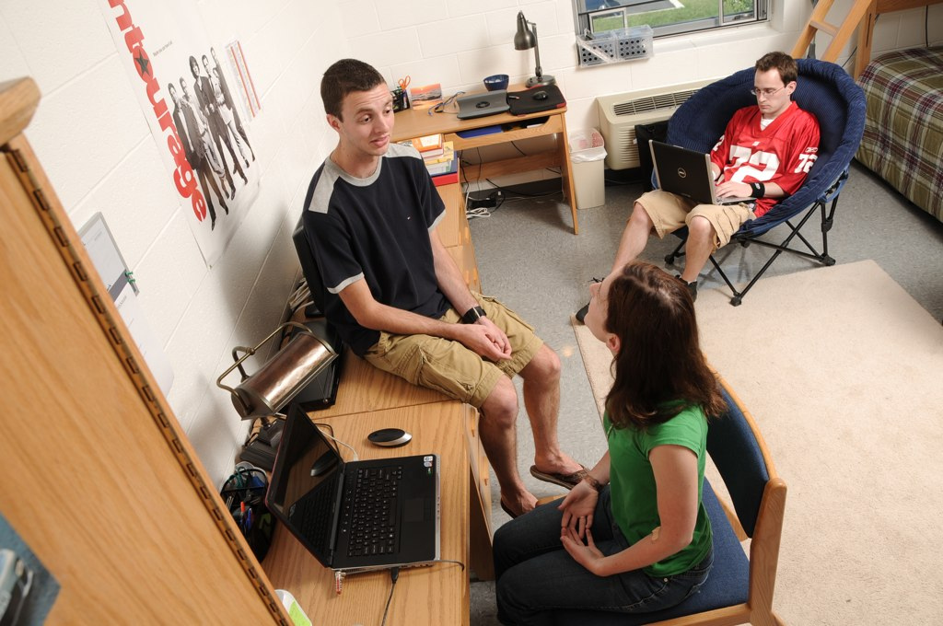
Social Issues that affect mental health
Navigating Social Life
  Roommates
  Social Circles (dorms, sororities, fraternities)
  Making new friends
  Separation from high school relationships (long distance and transitioning)
  Peer Pressure
  Social Anxiety

Slide 9
What can High Schools do to assist with the transition for struggling students?
Offer a program for all students Senior year on transition that includes a discussion on mental/emotional health
Speak to your student and parent about counseling supports on campus or in the area of the campus and encourage he/she to access them.
For students with identified mental health concerns, have student sign a release so you can communicate with the campus counseling center to facilitate a linkage from the moment the student arrives
Have a conversation about medication management while student is at school (what is the plan, who will prescribe, how will they obtain the medication)
Find out about support groups that may be available either on campus or in the area of the school
Notes:
Locally, the Mental Health Advocates of WNY (formerly Mental Health Association) offers a young adult support group as well as support groups for parents

Slide 10
When mental health issues go untreated
Students take longer to finish their degree
Students drop out
Suicide is the second leading cause of death for college students
Notes:
The stigma surrounding mental health issues and suicide on campus may be half the battle – students are often embarrassed about any mental health issues or ashamed about having mental health issues and as a result do not seek treatment/help.

Slide 11
2 million students enroll in some form of higher education each year
30% drop out in their first year
Over 40% graduate in 4 years
56% drop out by year 6
26% of full-time, public 2-year colleges graduate

Slide 12
Top reasons for dropping out sources: Bureau of Labor Statistics,Petersons, Washington Post,NY Times,Reuters,The Atlantic,Chronicle,Huffington post,US News,SSA,Employment Projects, BLS.gov,NSC Research Center,National Center for Education Statistics,NBC News,NBC News – 2,Slate.com
Finances
Failing
Full-Time work
Family
Stress
Undecided
No need
Unprepared
Distance
Housing
Personal emergency
Bad fit
Partying
No Mentor
Homesick
Health
Life
Moving
Burn out
Notes:
When students drop out due to psychological concerns everyone loses, including the student, their future aspirations, the institution and its ratings, loss of tuition and alumni dollars, and potential impact on the campus culture.

Slide 13
Seeking Support On College Campuses
Disability Services
Counseling Services
Support groups
On campus Medical Clinics
What does your specific school offer?

Slide 14
Resources Available
Mental Health Advocates of Erie County www.mhawny.org or Mental Health Association/ Alliance for the Mentally Ill in other communities
Prevention Programs and Resources through American Foundation for Suicide Prevention www.afsp.org- It’s Real, More Than Sad, Talk Saves Lives
Mental Health First Aid Training for Campus Staff : Professors, Academic Advisors, Residence Life, Campus Security (Compeer of Buffalo)

